Slide 1
CS/COE 0447
Course Goals and Introduction to Assembly
wilkie (with content borrowed from:
Jarrett Billingsley
Dr. Bruce Childers)

Slide 2
Goals
The role of any introductory CS course is to demystify computation.
In the case of CS0447, we want to examine the processor and how it runs programs. (CS0449 then looks at the programs.)
Topics:
Data representation
Memory organization
How programs are executed
Program conventions (call stack, function calls, system calls)
Skills:
Understanding common bases (binary, hex, etc)
Logical operations
Reading logic diagrams
Assembly language (reading, writing, debugging!)

Slide 3
Where does CS0447 fit?
The “hardware-software” interface.
Where CS and EE overlap.
Each layer is affected by the layer above and below.
Often the higher layers are abstractions of the lower.
ISA: Instruction Set Architecture
A programmer’s interface to the computer hardware.
Logic Design: (CPU design, etc)
“how we make rocks do stuff”
Processors: do lots of things with math.
1502
Computational Theory
Algorithm Design
Applications
Operating Systems
ISA
Logic Design
Electrical Design
Physics
445
401
449
more abstract more concrete
447
ECE 257

Slide 4
Goals
Learning Assembly!
“Unlearning” Java
Java is at higher a level, and thus abstracts a lot.
We now get to learn what we’ve taken for granted!
“Learning assembly is like a car mechanic learning how an engine runs”
A “normal” person doesn’t need to know this…
But we’re not normal, are we…
It’s fun to take things apart sometimes… so, let’s take apart a computer.
And then put it back together again.

Slide 5
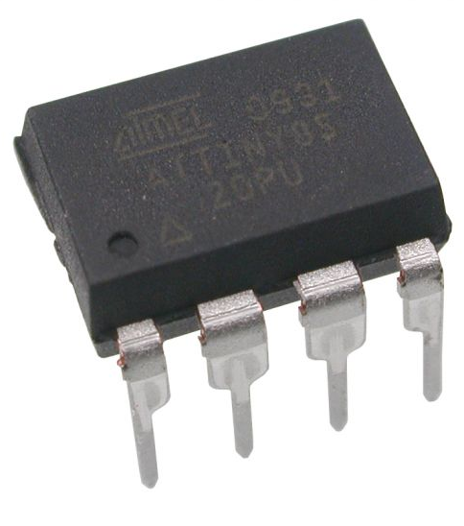
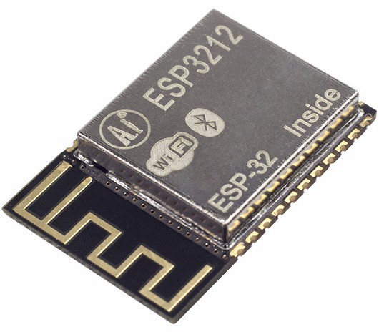
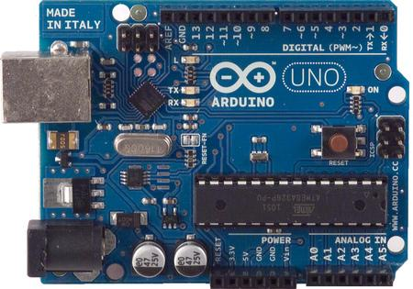
Classes of Computer: Embedded
“Microcontrollers”
8-bit and 16-bit architectures
Still VERY common
As little as 32 bytes of memory
Generally runs a single program
Low-power, low-cost, small
Mass-produced
More common every day
Most computers are embedded systems
Internet-of-things
A person can now hack your lightbulb
“What a stupid future”
Unless we get it right, I guess.

Slide 6
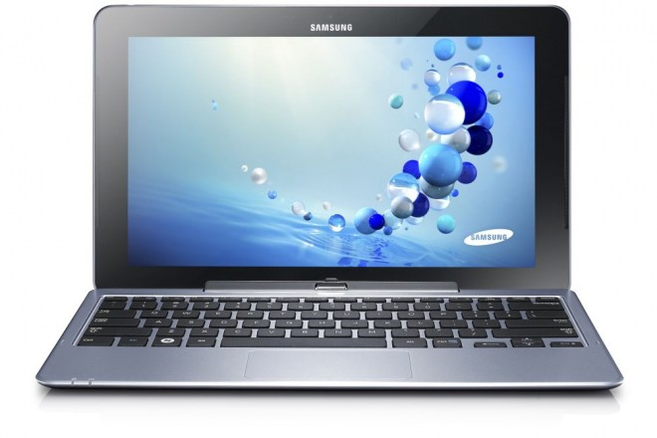
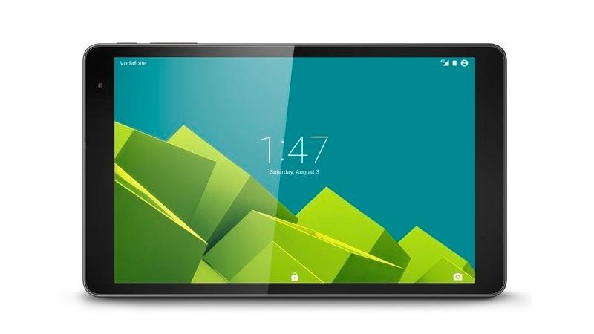
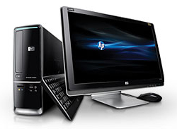
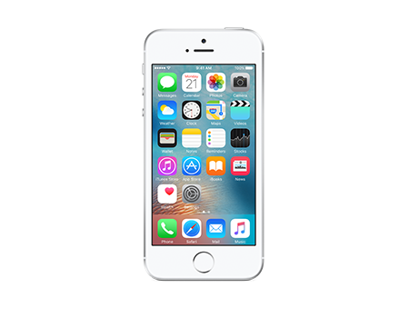
Classes of Computer: Consumer
“Desktop” but also “Mobile”
1-8 cores, 32 or 64-bit architectures
GB of memory with GB/TB of storage
Multitasking operating systems
Focused on real-time interactivity (browsers, games PowerPoint, etc)
Do we live in a “Post-PC” world?

Slide 7

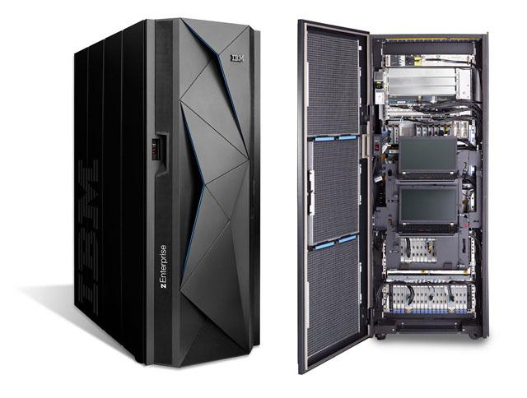
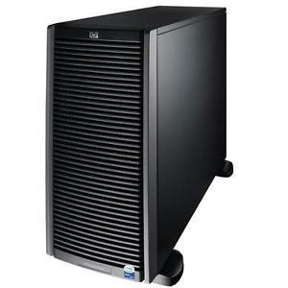
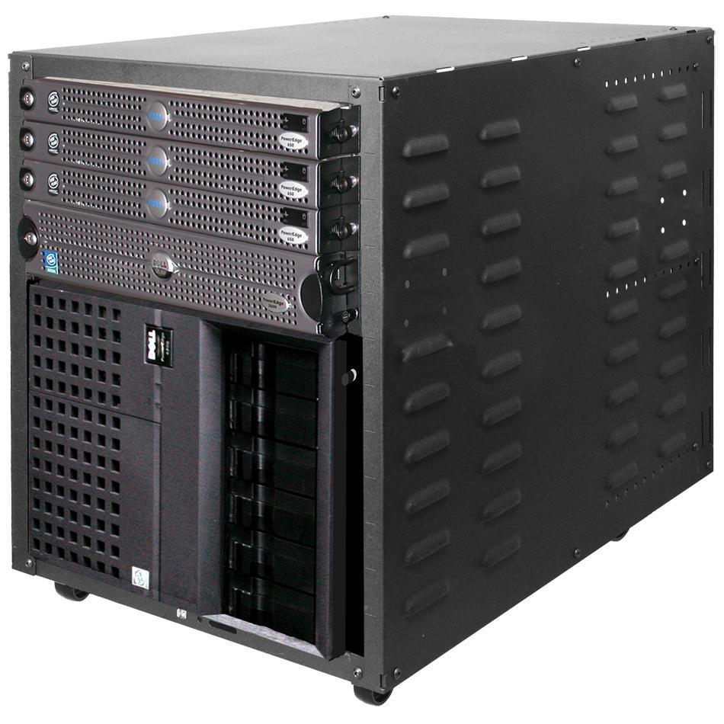
Classes of Computer: Server
“Servers”, “Mainframes”, “Racks”
12+ cores, multiprocessors
128+GB of memory, storage systems
Very fast networking.
Focused on real-time data delivery (websites, video game servers, banking…)
Design goals: redundancy (reliability), hot-swappability, availability.
Power and cooling become huge concerns
Goal: 100% uptime!
Is that possible?

Slide 8
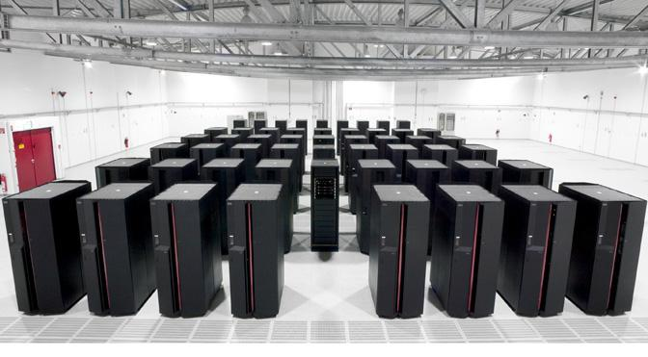
Classes of Computer: Supercomputer
Clusters of thousands of CPUs
Focused on consuming ENORMOUS datasets (non-interactively)
Science, research, design, and simulation.
Stock trading, financial speculation, “cryptocurrencies” ...

Slide 9
Computer Organization
Memory
Persistent Storage
Control
Registers
Datapath
Other Peripherals
Other Computers
Processor
Input/Output Devices
Network

Slide 10
What is “Assembly”
Assembly: Human-readable representation of machine code.
Machine code: what a computer actually runs.
The “atoms” that make up a program.
CPUs are actually fairly simple in concept.
(Yet we have an entire semester to fill, hmm)
Each CPU chooses its own machine code (and therefore its own style of assembly language)
We are using MIPS
Not that common, unfortunately.
Yet, often found in surprising places. (Nintendo 64, PS1/2, FPGAs)
But, very influential, and most common assembly looks like it.
ARM is a similar-ish ISA which is seeing much more usage

Slide 11
What is “Assembly”
Involves very simple commands.
This command copies data from one place to another.
In spite of being called “move”, ugh!
Surprise! It’s actually shorthand for a different set of instructions.
The processor can be made simpler.
This command gets transformed into a numerical representation.
More on that later!
The processor then interprets the binary representation.
That’s essentially all a computer does!
We will design such a processor!
mov a0, t0
-> add a0, t0, zero
-> 00000001000000000010000000100000
Compute t0+0 Put into “a0”

Slide 12
Is Assembly Useful?
Short answer: YES
Assembly is “fast”, so we should use it for everything! --- NO!!! ---
No type-checking, no control structures, very few abstractions. --- Fairly impractical for large things ---
Tied to a particular CPU.
So, large programs have to be rewritten (usually) to work on new things.
Yet: good for specialized stuff.
Critical paths and “boot” code in Kernels / Operating Systems
HPC (simulators, supercomputer stuff)
Real-time programs (video games; tho increasingly less / abstracted away)
And…

Slide 13
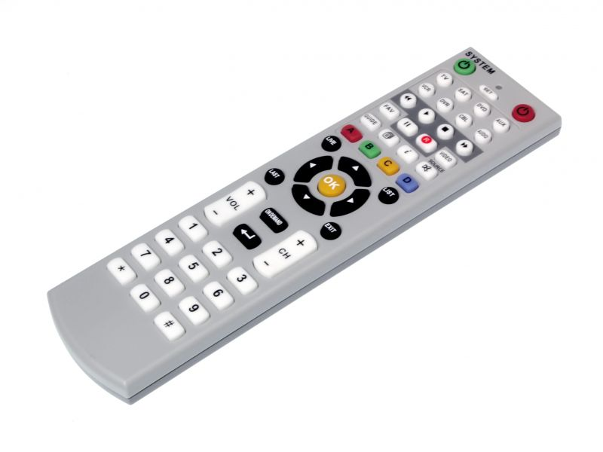
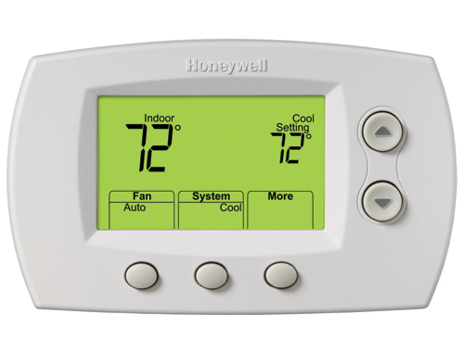
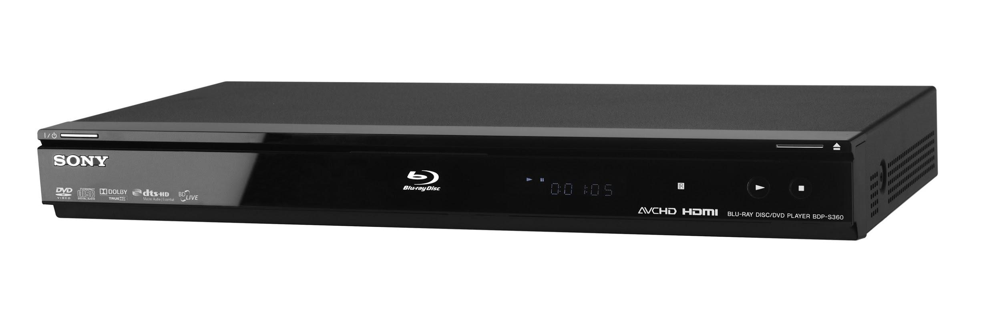
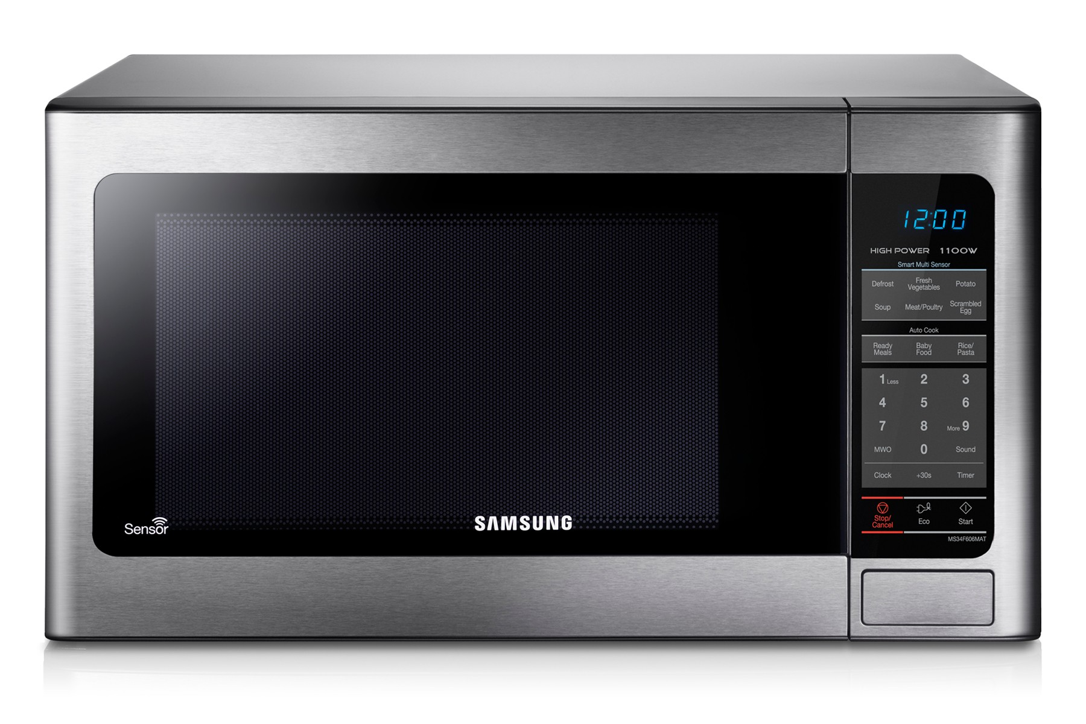
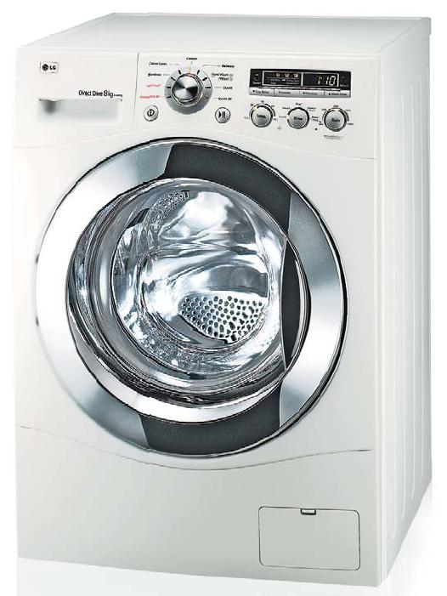
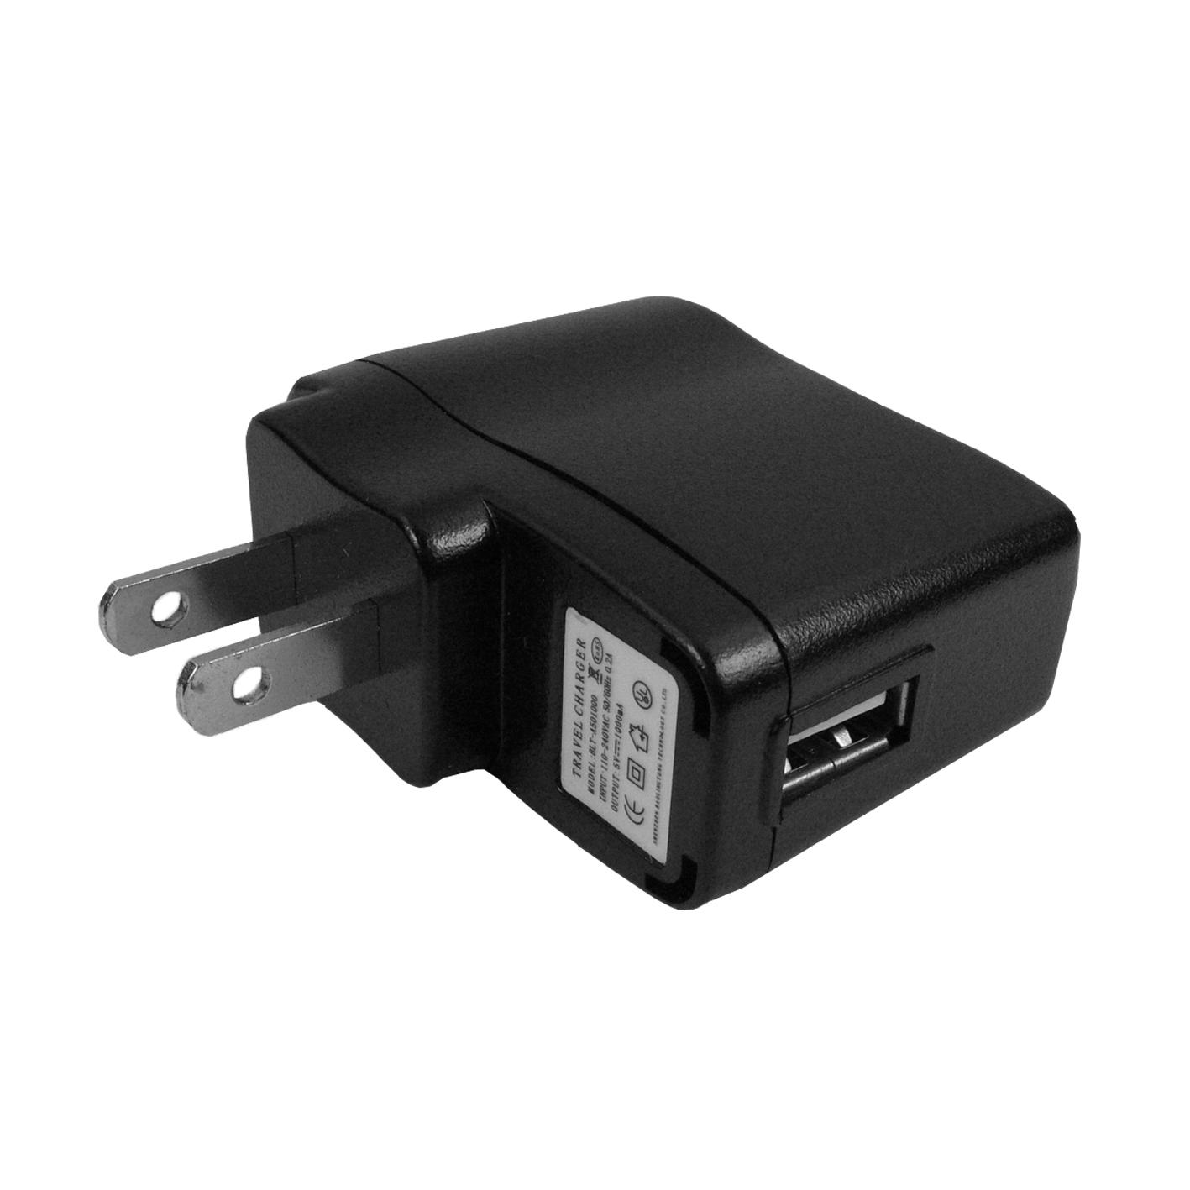
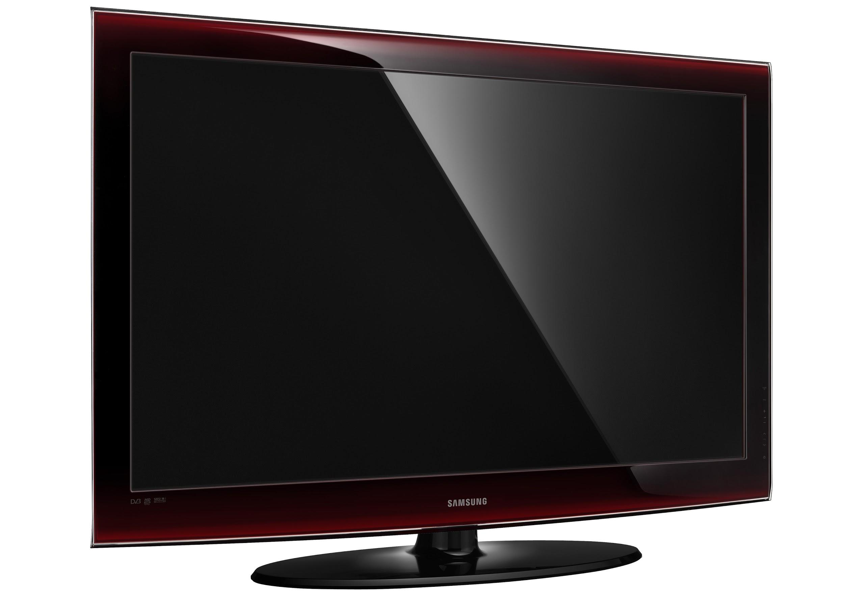
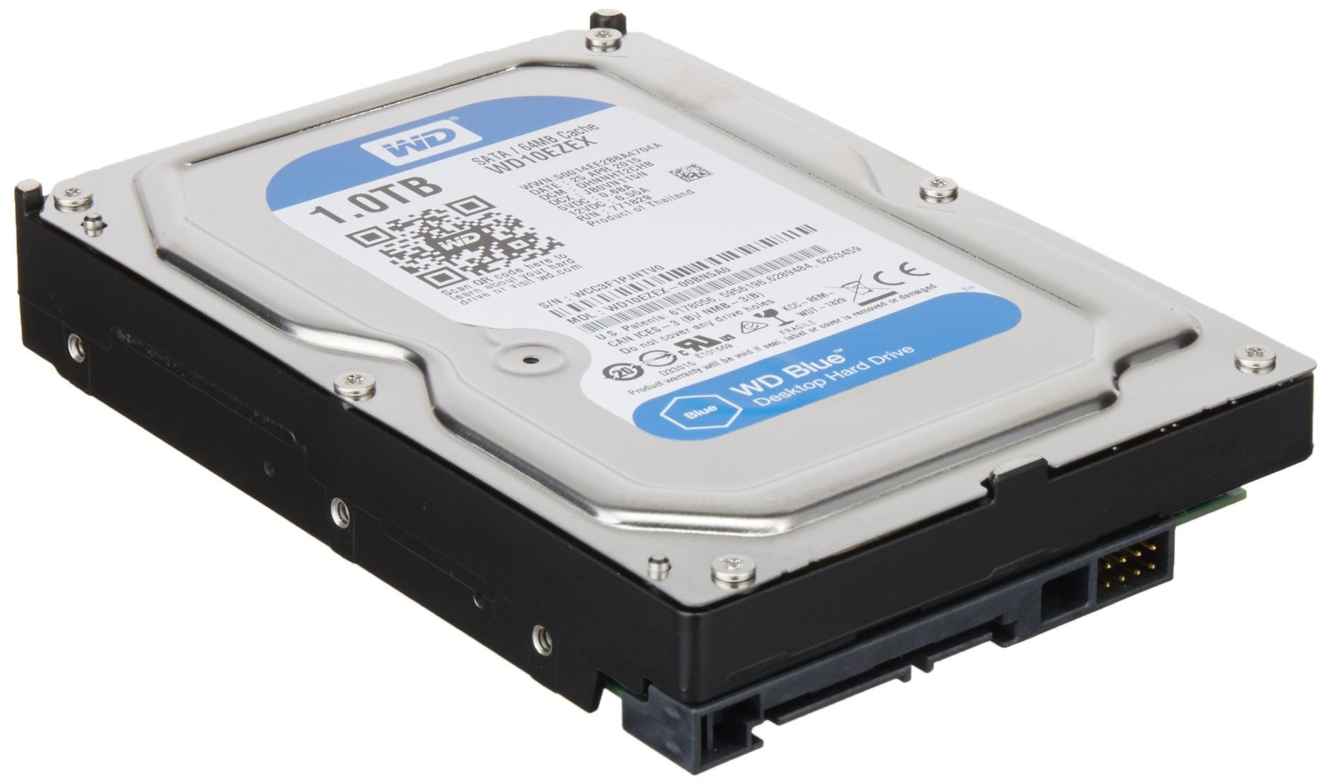
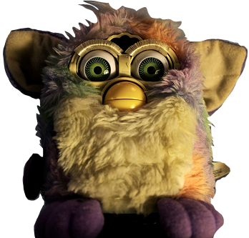
Embedded Systems
You’d be amazed at how many consumer devices have CPUs.
Many are programmed largely/entirely in assembly (or C)

Slide 14
Embedded Systems

Slide 15
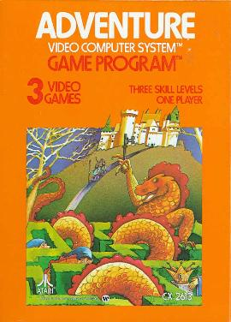

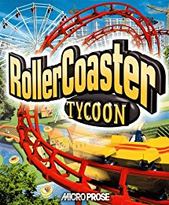
Practical Applications of Assembly: Real-time
Examples of games programmed mostly/entirely in assembly.
(Common in the 70s/80s; not at all common today)
Aside: https://all-things-andy-gavin.com/2011/03/12/making-crash-bandicoot-gool-part-9/
OMG WHY ?
(Generated Assembly … Cheating?)
1980: 8-bit 1.19 MHz
1994: 32-bit 33 MHz
1999: 32-bit 200 MHz

Slide 16
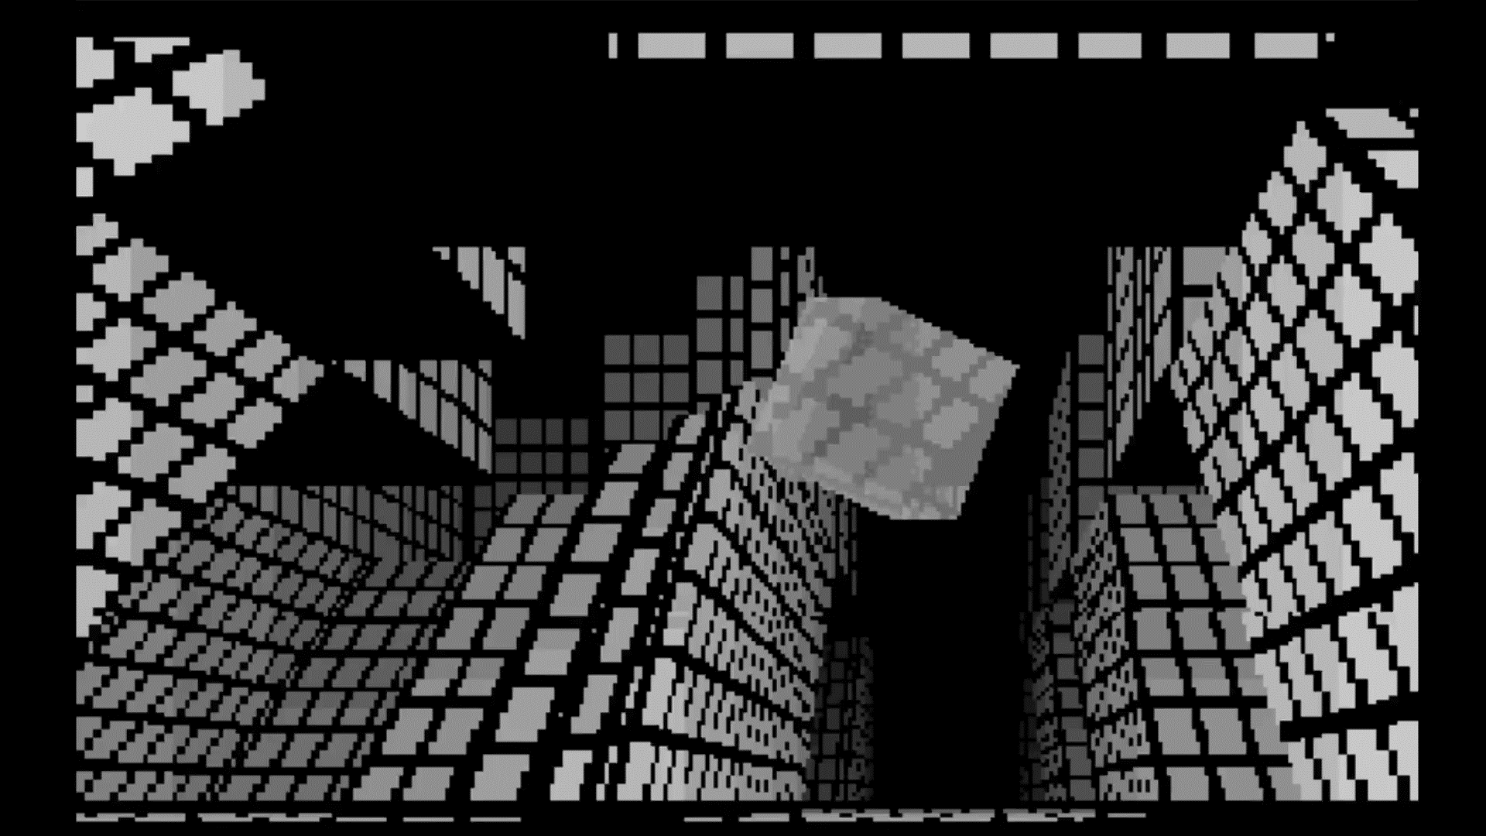
Practical Applications of Assembly: Art
b equ byte
w equ word
d equ dword
org 100h
mov al,13h
int 10h
mov fs,w[bx]
mov dx,l
mov ax,251ch
int 21h
a:and bp,0ffh
jnz c
xor b[cs:l],8
xor w[f],4a91h
c:mov si,140h
mov cl,0ffh
e:mov bx,cx
…
“Futura”
256 Byte Program:
http://www.pouet.net/prod.php?which=66806

Slide 17
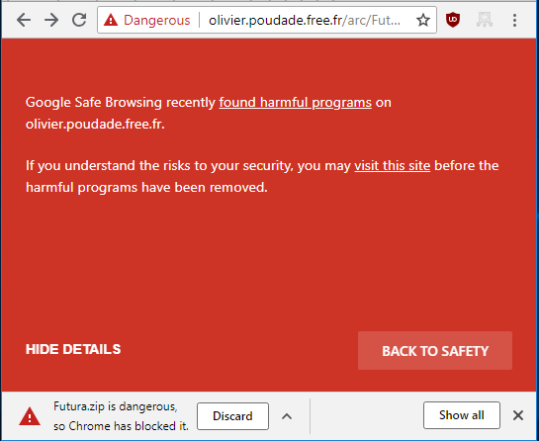
Practical Applications of Assembly: Art
Sometimes, the unusual construction of these programs confuse analysis:
OMG
Google
Chill the freak out…

Slide 18

Practical Applications of Assembly: Modification
Modifying programs after-the-fact. (Or reverse-engineering them)
Legal “gray-area,” / “confusing-mess” but generally modification/reverse engineering is allowed. Kinda? (Section 1201, US Code 17 § 108, etc)
Removing copy protection in order to preserve/backup.
Librarians and preservationists and “pirates” alike may all use/view/write assembly for this!
I patched (the freely distributed) Lost Vikings so it would avoid copy protection and use a different sound configuration (so I could run it in a browser emulator)
Don’t arrest me plz
; patching some bytes
; assembled with: `nasm -fbin -o patch.com patch.asm`
org 0x100 ; .com files always start 256 bytes into the segment
mov ax, 0x00
mov dx, msg ; the address of or message in dx
mov ah, 9 ; ah=9 - "print string" sub-function
int 0x21 ; call dos services
mov dx, fname ; open file to patch
…

Slide 19
Practical Applications of Assembly: Debugging
Programs written in C, etc are generally translated into assembly.
And then into machine code.
Or you can look at the machine code of programs and get an assembly code listing.
And step through the program one instruction at a time.
When programs crash (sometimes programs you don’t have the code for) you can look at the assembly code and assess.
Programs exist to help you (gdb, IDA Pro, radare, etc)
In CS 449 you will apply this knowledge (using gdb).

Slide 20
Next Time…
We will look at data representations!
How do computers store different types of data?
Numbers
Letters??
Color/Images??
And look at different numeric bases.
Decimal (our comfort zone)
Binary
Octal??
Hexadecimal

